Slide 1
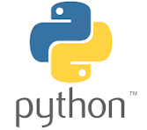
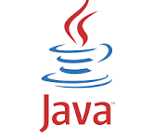
COMPARING PYTHON AND JAVA
CHARACTERISTICS, USE CASES AND ADVANTAGES

Slide 2
INTRODUCTION
Brief Overview of Python and Java
Python: High-level, interpreted language
Java: High-level, compiled language

Slide 3
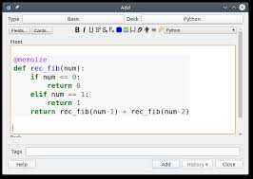
LANGUAGE CHARACTERISTICS (PYTHON)
KEY FEATURES OF PYTHON
Interpreted Language
Dynamic Typing
Simple Syntax And Readability
Extended Standard Library

Slide 4
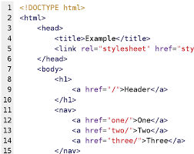
LANGUAGE CHARACTERISTICS (JAVA)
KEY FEATURES OF JAVA
Compiled Language (bytecode).
Static Typing
Confidence-building stratgie
Object-oriented with a strict syntax
Rich API And Libraries

Slide 5
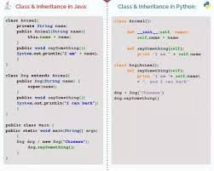
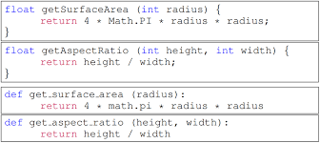
SYNTAX COMPARISON
Comparing Syntax Examples;
Example of a class in Python vs. Java
Example of defining a function in Python and Java

Slide 6
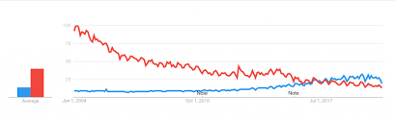
PERFORMANCE CHARACTERISTICS
PYTHON: Generally slower due to being interpreted.
JAVA: Generally faster due to complication and JVM optimizations.

Slide 7
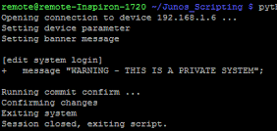
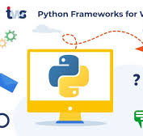
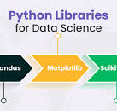
Effective delivery techniques
USES CASES - PYTHON
TYPE USES CASES - PYTHON
Effective body language enhances your message, making it more impactful and memorable.
Meaningful eye contact
Purposeful gestures
Maintain good posture
Control your expressions
Web Development (Django, Flask)
Data Science And Machine Leaning (Numpy, Pandas, Tensorflow)
Automation And Scripting

Slide 8

Navigating Q&A sessions
USES CASES - JAVA
TYPE USES CASES - JAVA
Enterprise Applications (Java EE)
Andriod App Development
Large-scale Systems And Web Servers

Slide 9
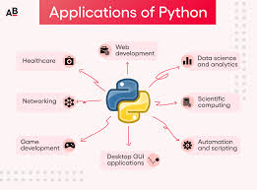
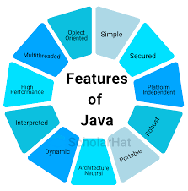
ADVANTAGES - PYTHON
ADVANTAGES - JAVA
Easy to learn and use.
Platform Independence (Write Once, Run Anywhere).
Strong Community Support.
Robust And Secure.
Rapid Development And Prototyping.
Extensive Ecosystem And Tooling.

Slide 10

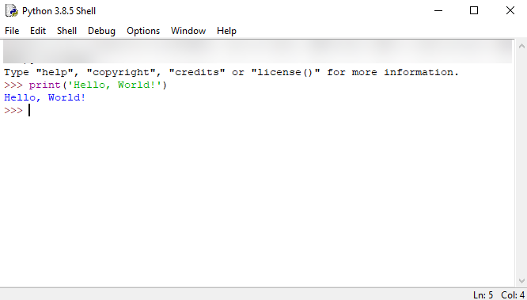
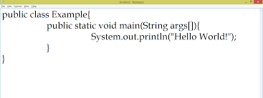
Side-by-side comparison of simple code examples
CODE EXAMPLES
Example of a “Hello World” program
in both languages.

Slide 11
Final tips & takeaways - Summary
PYTHON: Ideal for rapid development, data science and scripting.
JAVA: Suitable for large-scale, high-performance applications and Android development

